Slide 1

Human activity recognition
Prepared by: Ahmad Abdel-Qader

Slide 2
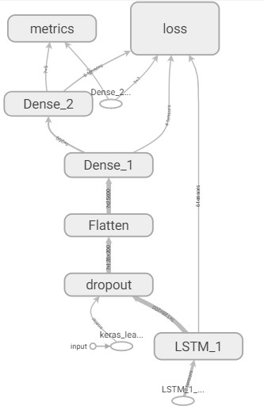
Recurrent Neural Network Structure:

Slide 3
Sample N
Sample 3
Sample 2
…128
3
Sample 1
2
1
Acc-X
Acc-Y
Acc-Z
LinAcc-X
LinAcc-Y
LinAcc-Z
Gyro-X
Gyro-Y
Gyro-Z
RMS-A
RMS-L
RMS-G

Slide 4
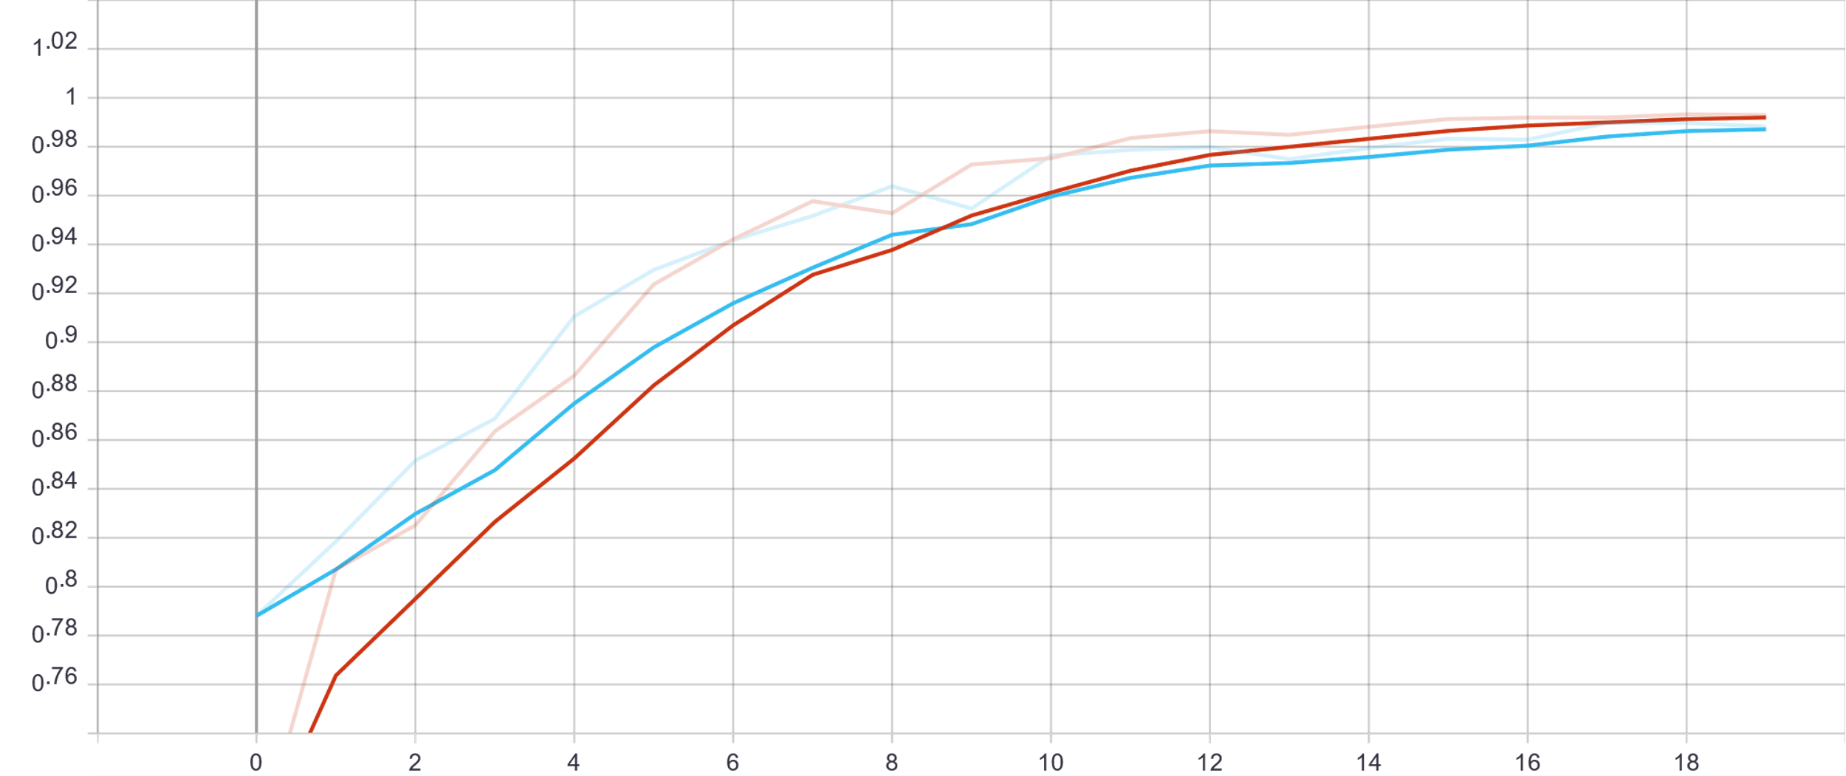
Training_acc
val_acc

Slide 5
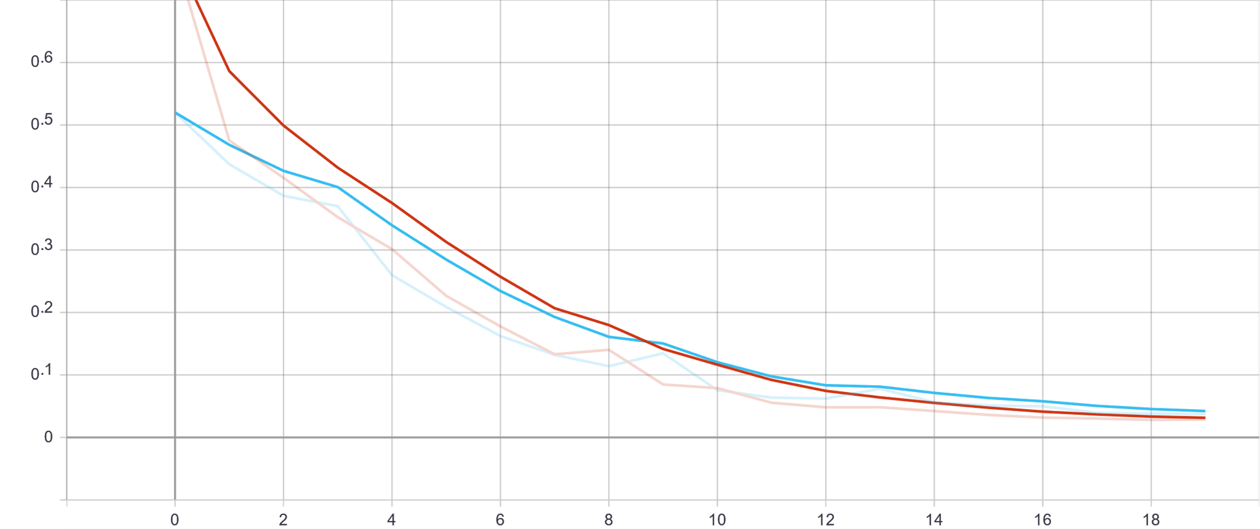
Training_loss
val_loss

Slide 6
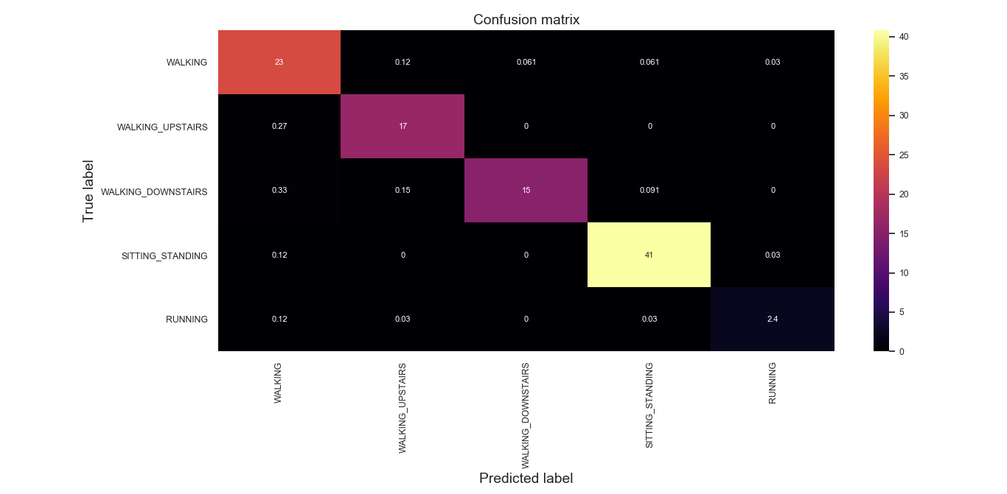

Slide 7
Results:
 | Number of data samples | Accuracy
Training | 6668 | 99.30%
Testing | 2628 | 98.82%
Prediction | 657 | 98.02%

Slide 8
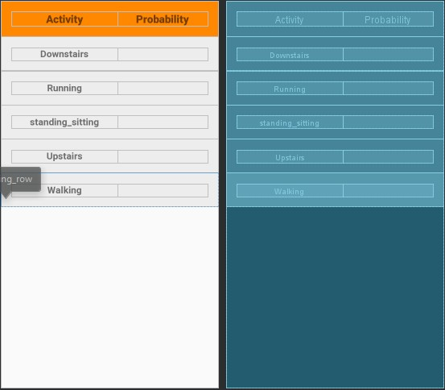
Android APP:
Take readings from Accelerometer and gyroscope data.
Do windowing on 50 Hz rate for 2.56s which result 128-time steps.
Calculate the features.
Use the above data as input to the RNN.
Output the probability for each movement.

Slide 9
Load the model to the phone:
Unable to use TensorFlow lite (LSTM is not supported yet).
We found a way to freeze the model, but to be compatible with mobile it must be converted to 8-bit.
Bazel + Graph_converter will do the necessary job, but few bugs need to be resolve first.

